Slide 1
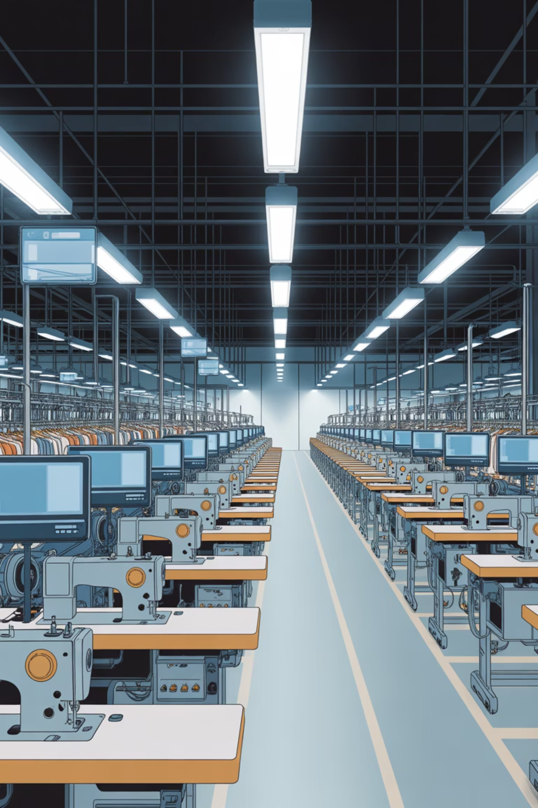
QR-Code–based Swing Machine Tracking System
Concord Apparel (Pvt) Ltd
EAD Group Project - Group B
20/04/2026
2025 | Faculty of Technology

Slide 2











Nirmalie Perera
Buddika Prabath
Tharushi Fernando
Imal Udyog
Leader, BSIT221001
BSIT221027
BSIT221003
BSIT221025
Team Members
Prasansa Nawanjalee
Malki Perera
Rashmi Fernando
Kavindu Pansilu
BSIT221015
BSIT221013
BSIT221011
BSIT221002
Nuwan Seneviratna
Rayani Fernando
Nimna Devindi
BSIT221016
BSIT221008
BSIT221006

Slide 3
01
Introduction
06
User Case Diagram
02
Problem Statement
07
Entity Relationship Diagram
Table of Content
03
Proposed Solution
08
Tools & Technologies
04
System Design
09
Project Timeline - Gantt Chart
05
System Overview (Flow Chart)
10
Project Demonstration

Slide 4
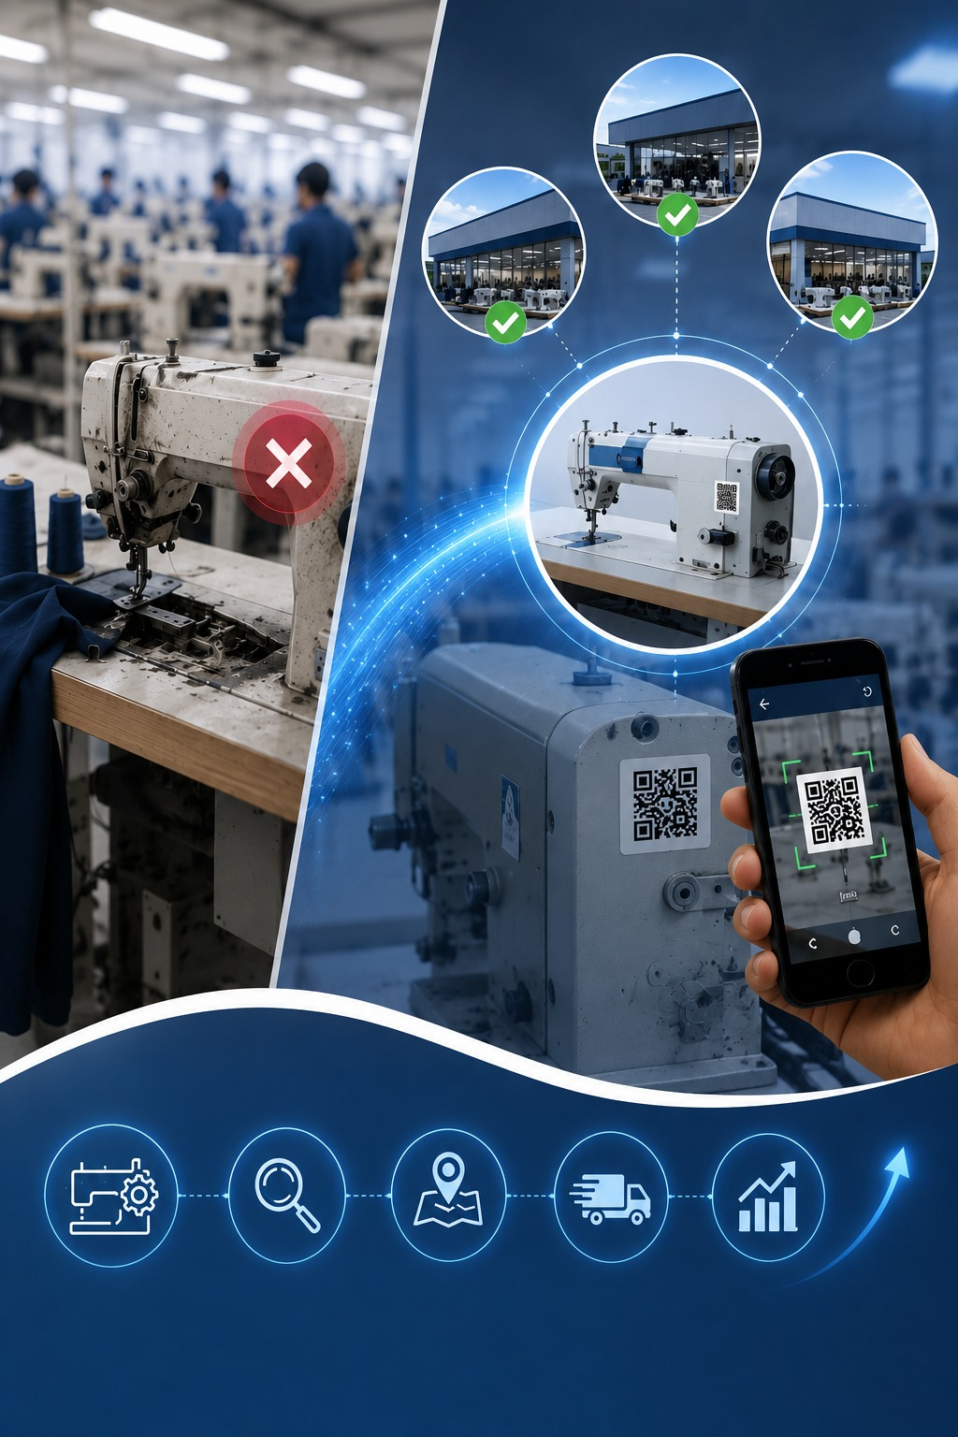
Introduction
The garment industry depends on sewing machines for continuous production.
When machines break down and cannot be repaired:
No centralized system to check machine availability across stores.
Manually finding a replacement is time-consuming.
Introducing a QR code–based machine tracking system that allows technicians to scan a machine, view its details, and quickly find matching machines in nearby stores. This helps reduce downtime, transportation costs, and unnecessary new purchases.
Page | 1

Slide 5
Problem Statement
1. No Centralized System
Manually locating a store with a matching machine is time-consuming, leading to delays in batch preparations.
2. High Cost - caused by Proximity Blindness
Nearby stores with available machines can be missed, leading to unnecessary long-distance transportation.
2. Higher Cost - from Outside Purchasing
If available and matching machines are not found, purchasing new machines from outside incurs high costs and delays.
.
Page | 2

Slide 6
Proposed Solution
Implement a QR-Code-based Machine Management System for Tracking Machines
1
2
3
4
5
Scan QR Code
System Searches
Proximity Sort
Request Machine
CM Approval
Technician scans the faulty machine's QR code using QR Scanner.
System queries database for matching machines available in stores.
Results will be sorted by distance using GPS coordinates of stores.
Technician selects a machine and sends a request to Chief Manager.
Chief Manager reviews and approves the transfer request.
Page | 3

Slide 7
System Design
INPUT
PROCESS
OUTPUT
Machine QR Code
QR code decode
List of stores with matching machines sorted by distance
Transfer/Purchase request
Searching matching machines
Request approval/rejection status
Machine Details
Distance calculation (lat/lng)
Display added/edited details of users, machines, stores, and garments
Store Details
Sort by proximity
Transfer/purchase history
Garment Details
Add/edit/delete/view details of users, machines,, stores, and garments
Informative notification.
Page | 4

Slide 8
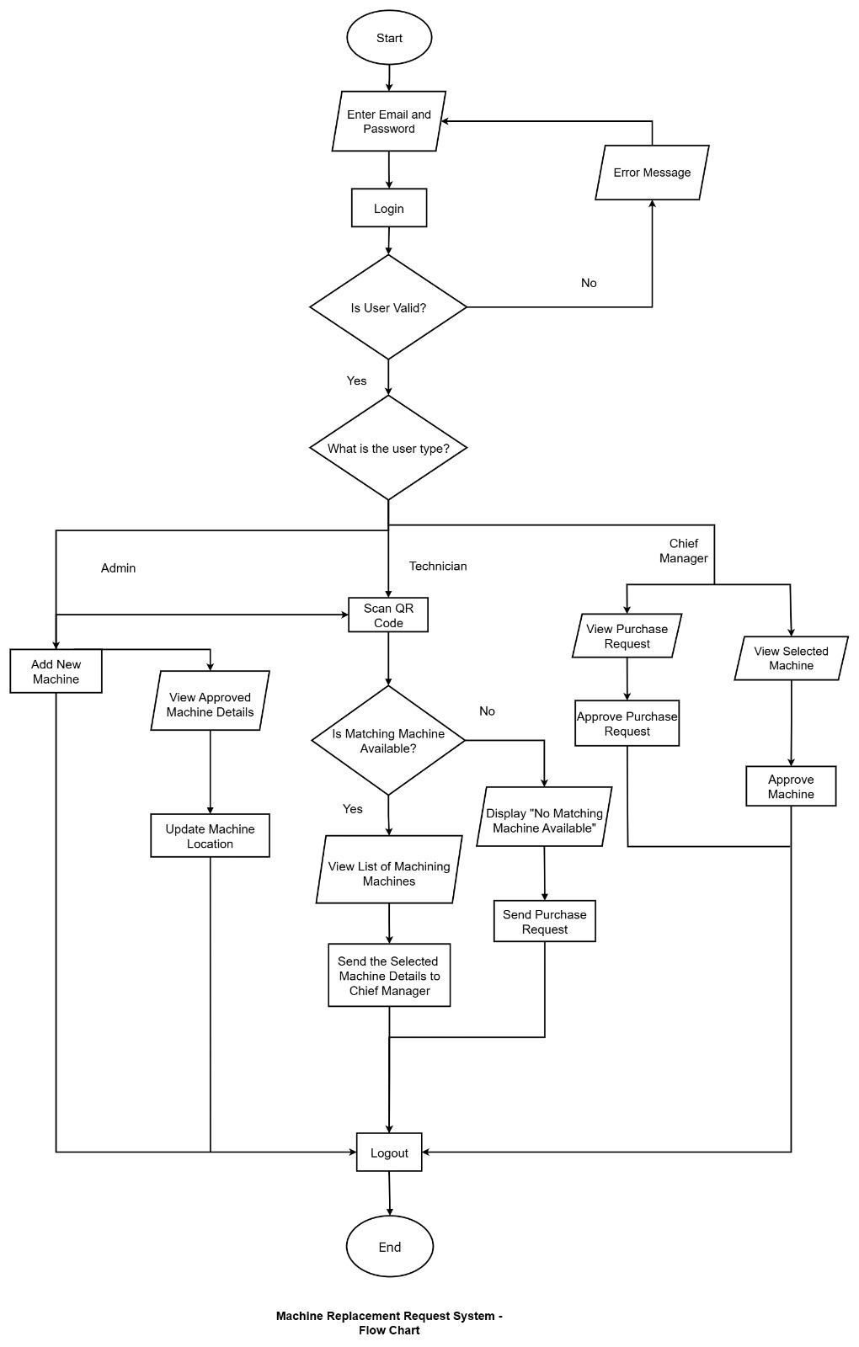
System Overview (Flow Chart)
Page | 5

Slide 9
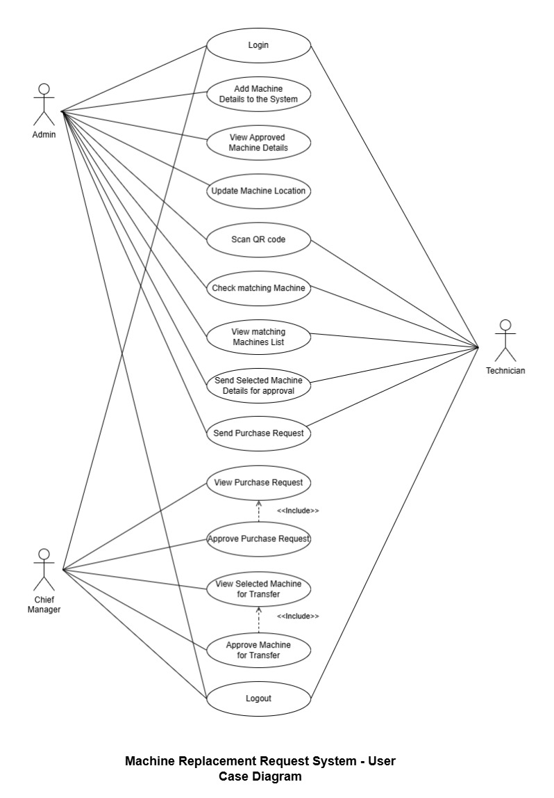
Use Case Diagram
Page | 6

Slide 10
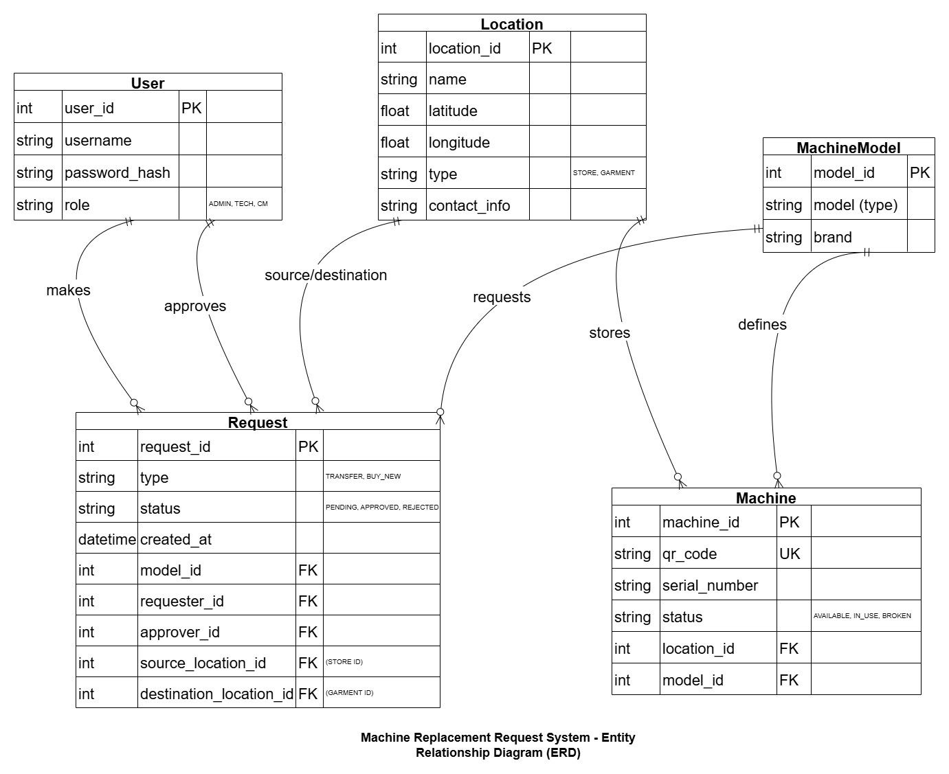
Entity Relationship Diagram
Page | 7

Slide 11
Tools & Technologies
Backend
Frontend
Spring Boot (Java Framework)
React.js
RESTful API, business logic, security
Interactive UI, QR scanner integration
MVC
Model
Backend Services, Data Management
View
Frontend Components
DevOps & Tools
Controller
Docker
Backend Controllers, Frontend Logic
Containerization & deployment
Git
Database
Version control & collaboration
PostgreSQL
Relational DB, spatial queries
pgAdmin
Database management GUI
Page | 8

Slide 12
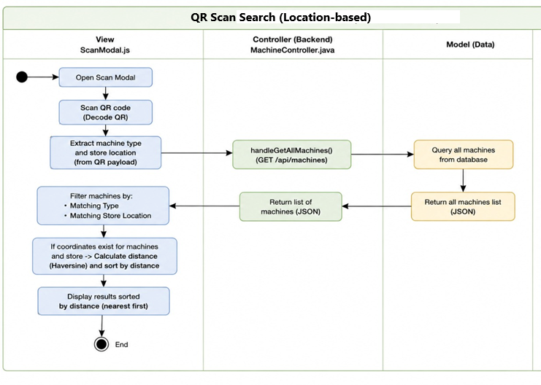
Activity Diagram
Page | 8

Slide 13
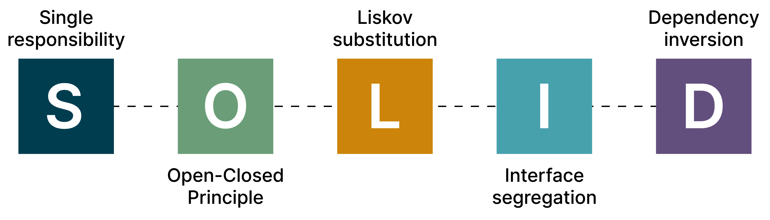
Page | 10

Slide 14
Project Timeline - Gantt Chart
Wk 1
Wk 2
Wk 3
Wk 4
Wk 5
Wk 6
Wk 7
Wk 8
Wk 9
Wk 10
Wk 11
Wk 12
Requirement Analysis
System Design
Frontend Development
Database Setup
Backend Development
Testing & QA
Resolving Bugs
Documentation
Final Review & Presentation
Page | 11

Slide 15
Project Demonstration
Page | 12

Slide 16
Thank You

